Slide 1

Statistical Fundamentals:
Using Microsoft Excel for Univariate and Bivariate Analysis
Alfred P. Rovai
Chi-Square Goodness-of-Fit Test
PowerPoint Prepared by
Alfred P. Rovai
Microsoft® Excel® Screen Prints Courtesy of Microsoft Corporation.

Slide 2
Chi-Square Goodness-of-Fit Test
The χ² goodness-of-fit test (also known as Pearson’s χ² goodness-of-fit test) is a nonparametric procedure that determines if a sample of data for one categorical variable comes from a population with a specific distribution.
This test is used to analyze a nominal or collapsed ordinal scale dependent variable where measurements are in the form of frequency counts for each category.
  More specifically, it can test whether or not a set of observed (i.e., measured) frequencies in each category of a single categorical variable matches one’s expectations.
Only use the χ² goodness-of-fit test to analyze a categorical (nominal scale) variable measured in frequencies and not percentages.

Slide 3
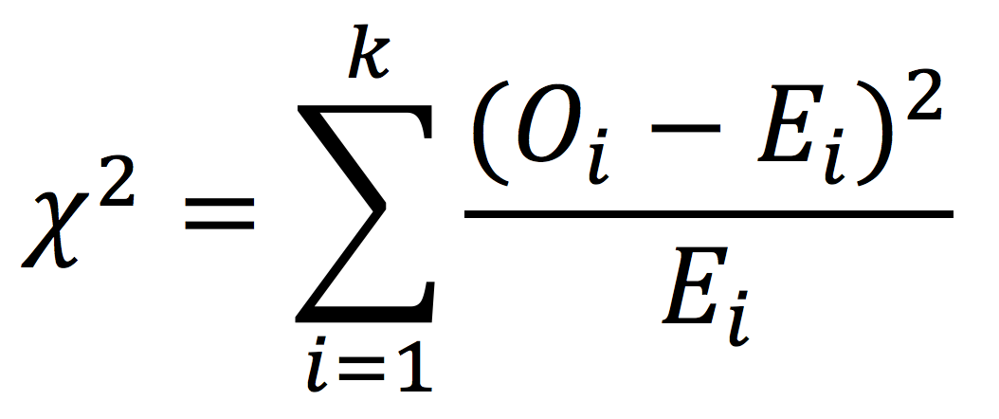
Chi-Square Goodness-of-Fit Test
One can compute the chi-square (χ2) test statistic using the following formula:
Where
  Σ = summation sign, directing one to sum over all categories from 1 to k
  O_{i} = observed frequency for category
  E_{i} = expected or hypothesized frequency for category
  k = total number of categories

Slide 4
Key Assumptions & Requirements
Random selection of samples (probability samples) to allow for generalization of results to a target population.
Independence of observations. Independence of observations means that observations (i.e., measurements) are not acted on by an outside influence common to two or more measurements, e.g., other research participants or previous measurements.
One categorical variable with two or more categories where categories are reported in raw frequencies. Values/categories of the variable must be mutually exclusive and exhaustive.
Observed frequencies must be sufficiently large. No more than 20% of expected frequencies should be below 5 with no expected frequencies of zero.

Slide 5
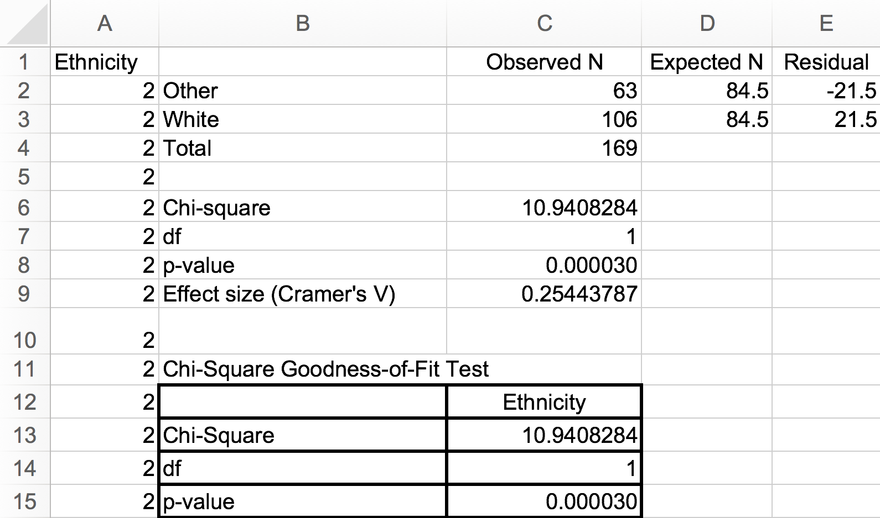
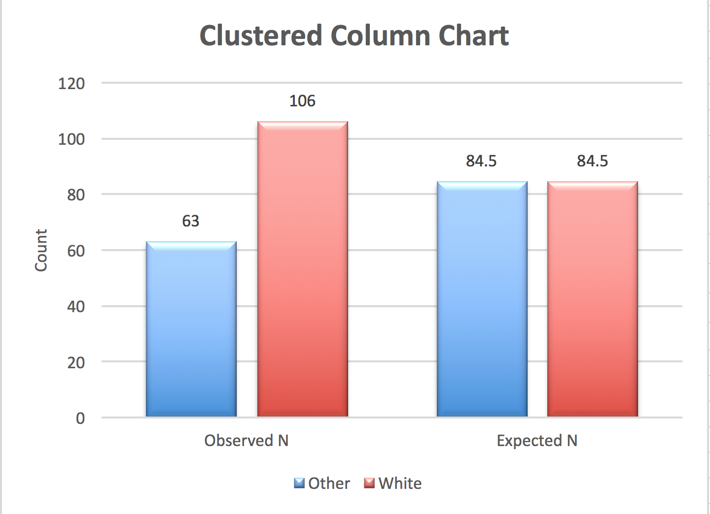
Conducting the Chi-Square Goodness-of-Fit Test
Open the dataset Motivation.xlsx. Click on the One-Sample t-Test worksheet tab.
File available at http://www.watertreepress.com/stats
TASK
Respond to the following research question and null hypothesis:
Is there a difference in the ethnicity of online college students? Note: ethnicity is measured as frequency counts across two categories (other = 2, white = 4).
H₀: There is no difference in the ethnicity of online college students (i.e., categories are equal).

Slide 6
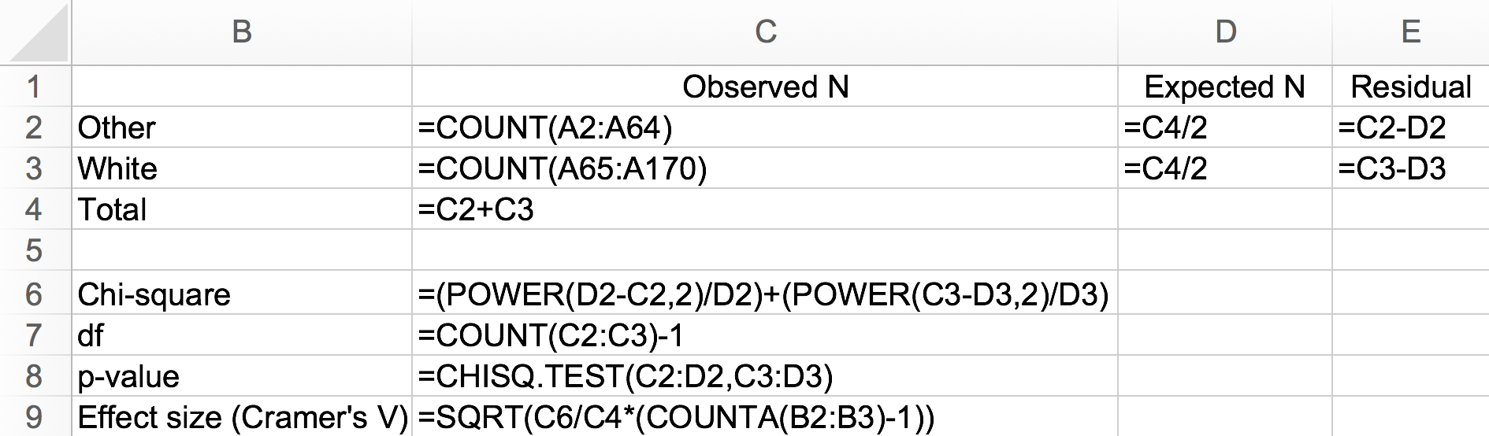
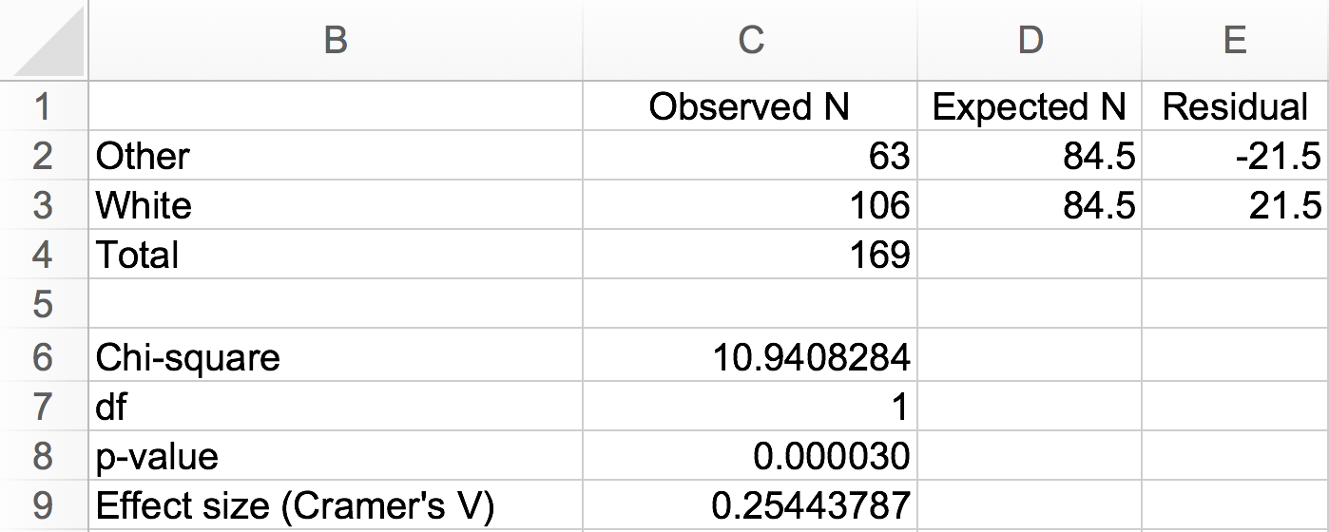
Conducting the Chi-Square Goodness-of-Fit Test
Go to the Chi-Square Goodness-of-Fit Test tab of the Motivation 3rdEd.xlsx Excel workbook. Enter the labels and formulas shown in cells B1:E9.

Slide 7
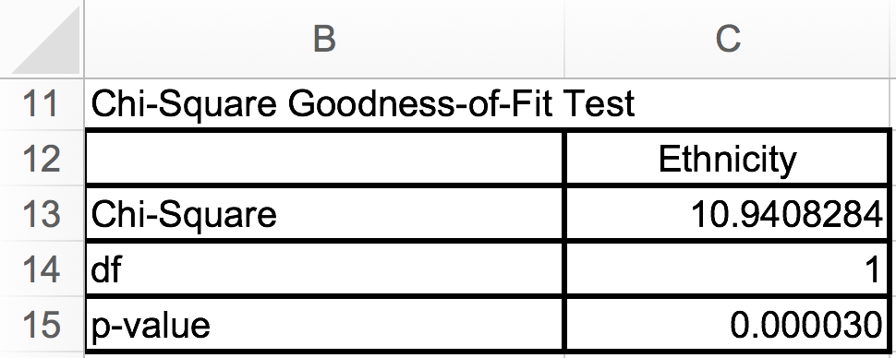
Test Results Summary
Test results provide evidence that there is sufficient evidence (p < 0.001) to reject the null hypothesis that there is no difference in the ethnicity of online college students.

Slide 8
Reporting Chi-Square Goodness-of-Fit Test Results
As a minimum, the following information should be reported in the results section of any research report: null hypothesis that is being evaluated, descriptive statistics (e.g., observed frequency counts by category, expected frequency counts by category, N), statistical test used (i.e., χ² goodness-of-fit Test), results of evaluation of test assumptions, and χ² goodness-of-fit test results. For example, one might report test results as follows. The formatting of the statistics in this example follows the guidelines provided in the Publication Manual of the American Psychological Association (APA).
Results
The chi-square goodness-of-fit test was used to evaluate the null hypothesis that there is no difference in the ethnicity of online college students (i.e., the categories of other and white are equal). The sample (N = 169) reported ethnicity as follows: other = 63 (expected = 84.5) and white = 106 (expected = 84.5). The test showed a statistically significant difference in the ethnicity of online college students, χ²(1, N = 169) = 10.94, p < .001. Consequently, there was sufficient evidence to reject the null hypothesis. Effect size as a measure of Cramer’s V was 0.25, which is considered moderate.

Slide 9
Chi-Square Goodness-of-Fit Testt-Test
End of Presentation

